Slide 1
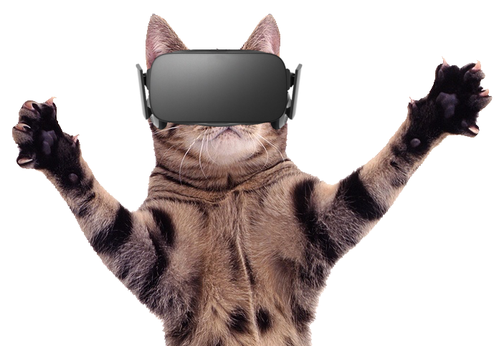
ScARtch
augmented-reality VISUAL environment for PROGRAMMING BEGINNERS
Matteo Boschini

Slide 2

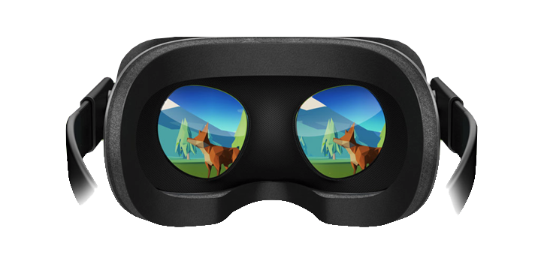
Purpose
Scratch is a coding learning enviroment that employs a block-based visual programming language.
Virtual Reality technology allows for intuitive and natural interaction with computers.
Applying the latter to the former simplifies user interaction (especially relevant if they are not used to traditional UI).

Slide 3
Objectives
Definition of a graphic block-based language built upon the structured programming paradigm with the following characteristics:
Instructions are represented by blocks that can be composed to obtain scripts.
Special blocks with intuitive shapes represent specific control structures.
Introduction of different types of variables and expressions.
Implementation of a message transmission system to allow an instruction to trigger other scripts.
(Limited) ability to provide input through VR controllers.
Realization of a development environment, called Playground, where the user can:
Build Scripts.
Run them and observe their effects on graphic elements.

Slide 4
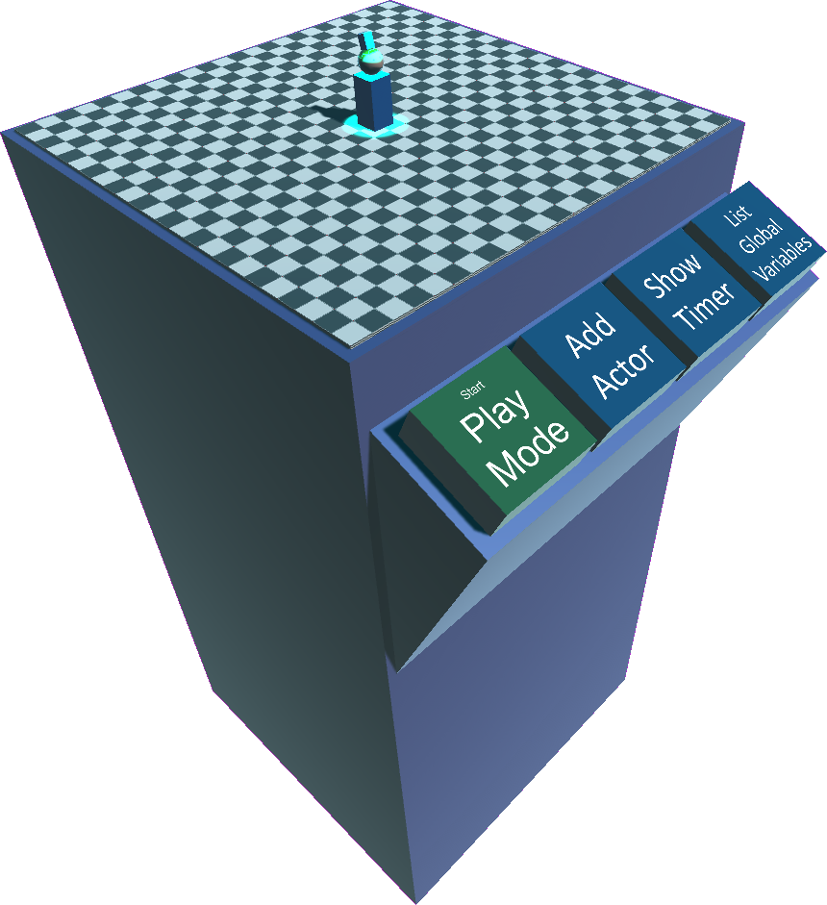
Overview
Playground
Scene: a static background
Actors: entities moving on the scene.
Sound and Models Archive: respectively sound effects and three-dimensional models that we can associate with actors.
Controls: In particular, to switch between the scripting mode (Edit mode) and execution mode (Play mode) and vice versa.
We associate every Actor with
A position, a rotation, a scale coefficient, and a sound volume value.
A three-dimensional model that represents it.
Scripts: programs that are assembled through the appropriate interface.
A message that can be used to provide output.

Slide 5

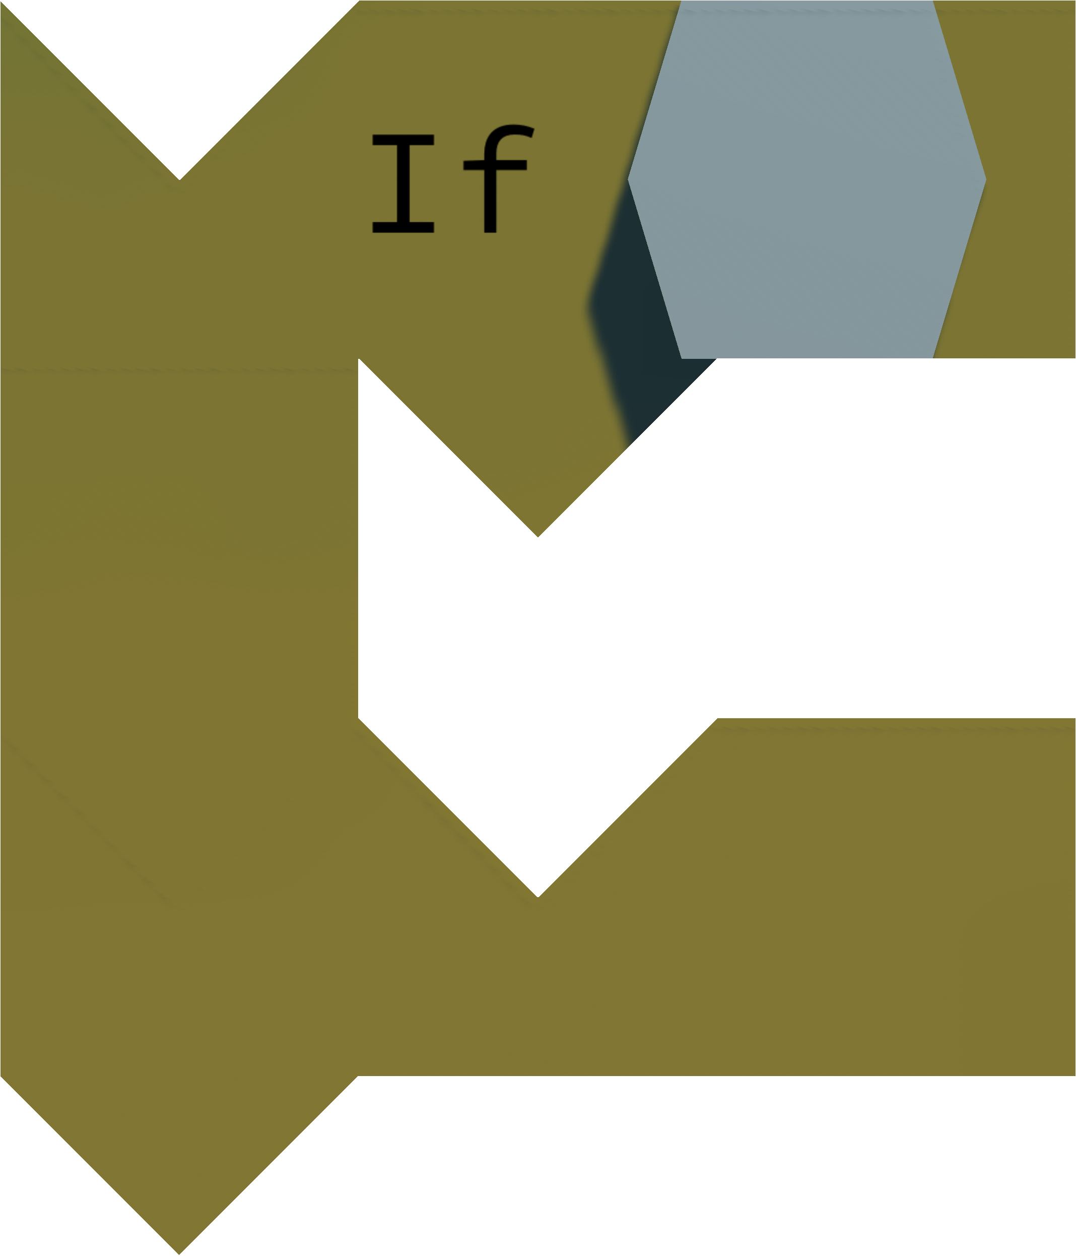
Scripting Elements (I)
Scripts are composed of the following elements:
Simple Blocks, containing a single statement.
Control blocks, Used for control structures (if, while,...). They have a port in which a sequence of additional blocks can be added.

Slide 6
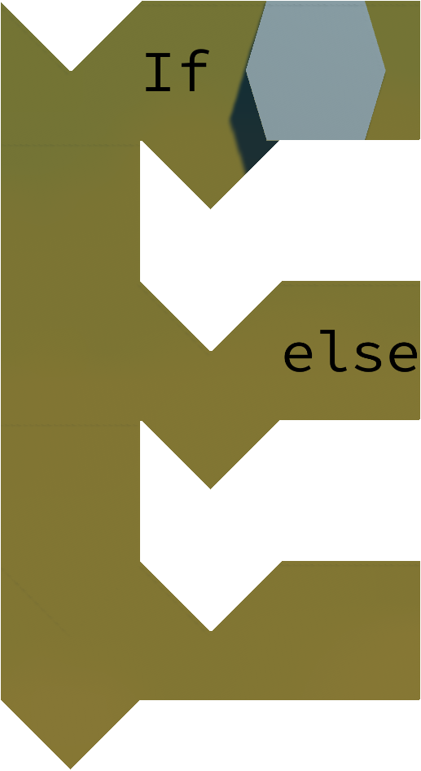
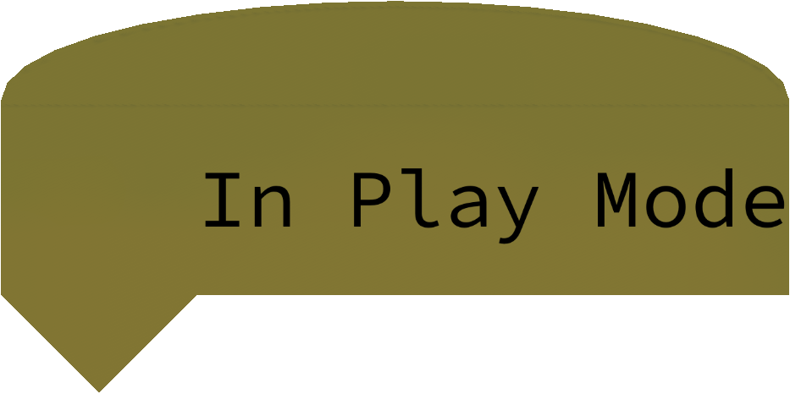
Scripting Elements (II)
Scripts are composed of the following elements:
Double control Blocks, used for the If/else control structure. They have two ports for the insertion of additional block sequences.
Hats, elements that begin scripts and contain their execution condition.

Slide 7



Scripting Elements (III)
Some blocks have boxes where operands can be inserted.
An operand is a variable or an expression of other operands. Both of these elements are represented with appropriate scripting elements.
An operand is always associated with a type (can be string, number, or Boolean). Numbers and Booleans can also be inserted in boxes that require a string. Different types of boxes and scripting elements are recognizable by their shape.

Slide 8
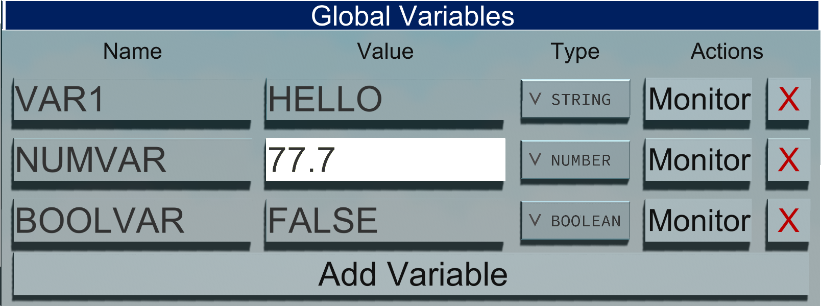
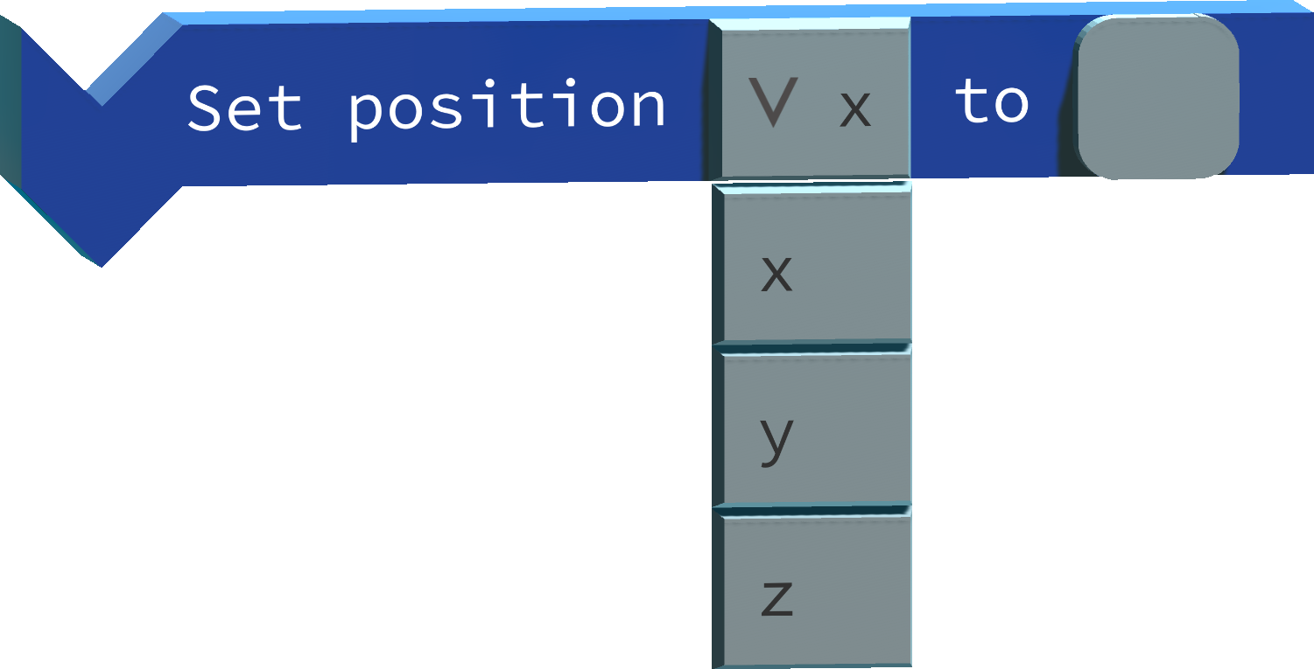
Scripting Elements (IV)
Variables are defined through the controls of the programming environment (separately from scripts), there are, however, instructions to assign them new values.
Some blocks have options: boxes with drop-down menus for selecting a value in a predetermined list.

Slide 9

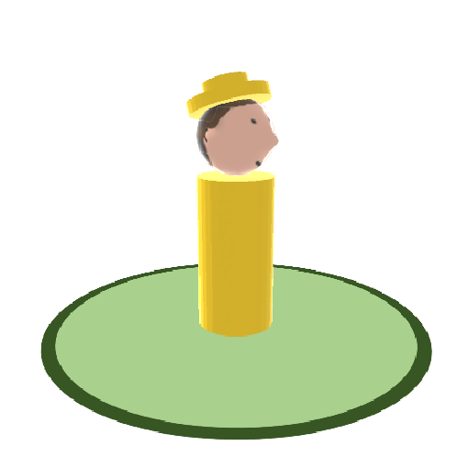

Scoping
Each actor defines local variables on which he has exclusive visibility.
Global variables that are visible to any actor can also be defined.
VAR1
VAR3
VAR2
VAR1
VAR4
VAR2
VARG1
VARG2
VARG3

Slide 10



Messages
An actor can broadcast a message that contains a string, triggering the execution of scripts that begin with the appropriate receiving hat.
You can take advantage of this mechanism for simulating function calls (without explicit arguments).

Slide 11


Visual Grammar (I)
Cappello
< >
=
+
Script
< >
Corpo

Slide 12

Visual Grammar (II)
< >
Blocco
< >
ε
< >
=
+
Blocco
Corpo
< >
Corpo

Slide 13



Visual Grammar (III)
< >
< >
=
Blocco Semplice
+
Corpo
Blocco
Cnt Block.
< >
Corpo
+
+
< >
Corpo
Double Cnt Block.

Slide 14

Evaluation (I)
In Play Mode, under certain conditions (e.g. hat), an execution flow is generated, which contains a pointer to the current block.
The block contains in its class the logic for evaluating and updating the flow with the next block.

Slide 15

Evaluation (II)
The script evaluation engine executes the instructions sequentially and with Time-Division. Instructions are kept in a queue of execution flows.
The first statement of the flow stream is executed.
Upon completion, if the flow still contains instructions, it is inserted in the back of the queue.
After a "didactic" waiting time, the first instruction of the following flow is executed.

Slide 16

Architettura dell’ambiente
Model
Scripting
Controller
View

Slide 17
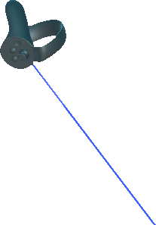
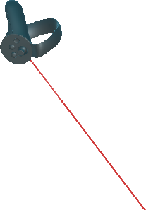
Interface (I)
The user displays the environment through a NewtonVR-compatible headset (i.e. Oculus Rift o HTC Vive).
You can move by teleporting (using buttons B/Y).
Interaction is possible through the controllers.
Windows and scripting elements can be grabbed (using the grip button).
Buttons, actors, textboxes, etc. allow for interaction with laser pointers (activated with buttons A/X).
The blue pointer is used for selection.
The red pointer is used for deleting items/closing windows.
During Play mode, only the blue pointer is available and you scripting elements cannot be moved.

Slide 18
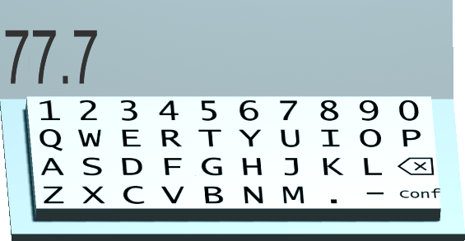
Interface (II)
For interactions that require textual input, a virtual keyboard is employed.
It is activated when by clicking the analog stick and appears near the controller.
Select a text area while the keyboard is open and assigns it focus.
Any virtual keyboard input is subjected to a compatibility check before being accepted. Syntax errors are filtered at this level.

Slide 19
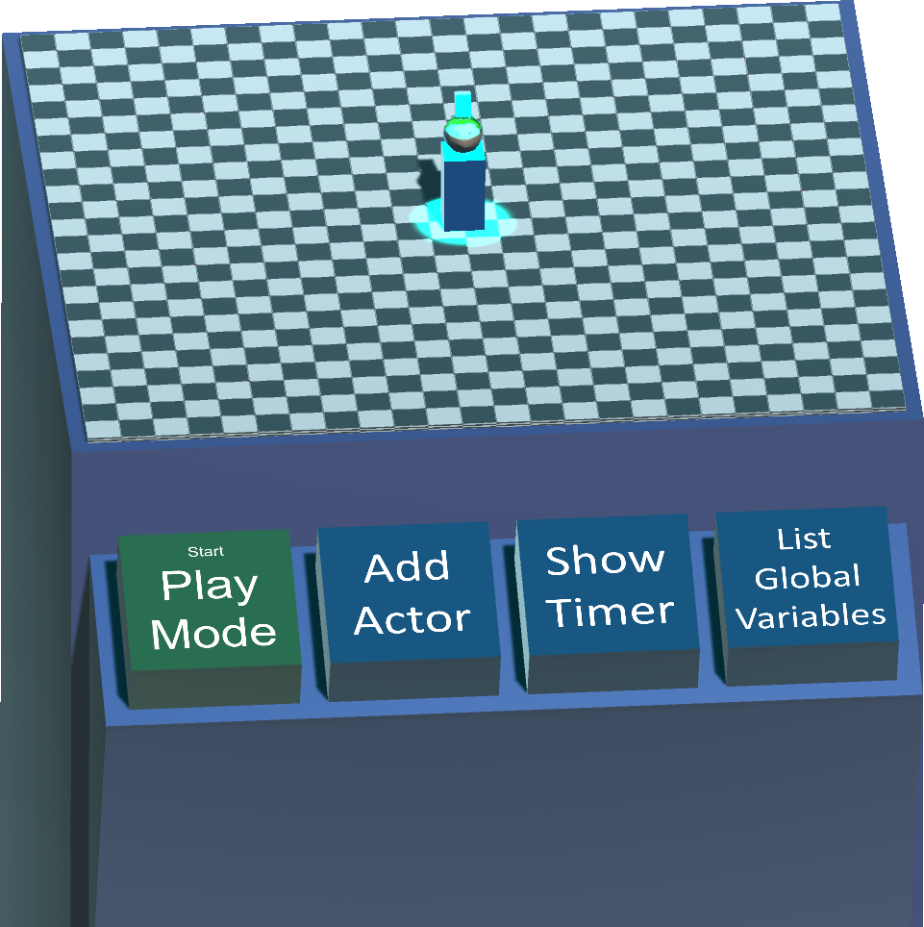
Interface (III)
At startup, the user finds an empty table in front of them, with several buttons.
Mode change (Play/Edit mode).
Actors insertion.
Timer Monitor toggle.
Global variables management window.

Slide 20
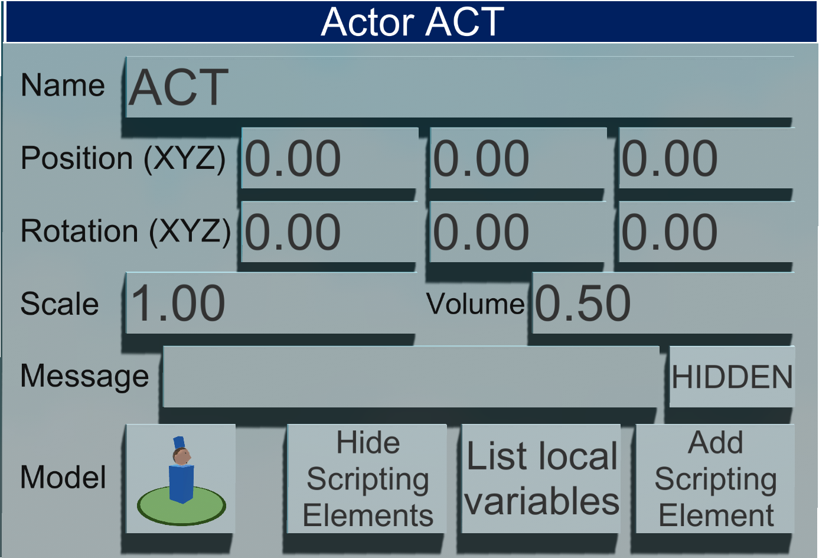
Interface (IV)
Selecting an actor highlights it and makes its Actor Window appear.
Use it to manually view and edit all the parameters related to the actor.
Use it to access local variables management and scripting element insertion sub-menus.

Slide 21
Interface (V)
A variable management window contains the list of all variables that are associated with a given scope.
You can change the name and/or type of the variable only if there are no active references to that variable in any script.
You can change the value of the variable.
You can open a monitoring window that shows the value of the variable.

Slide 22
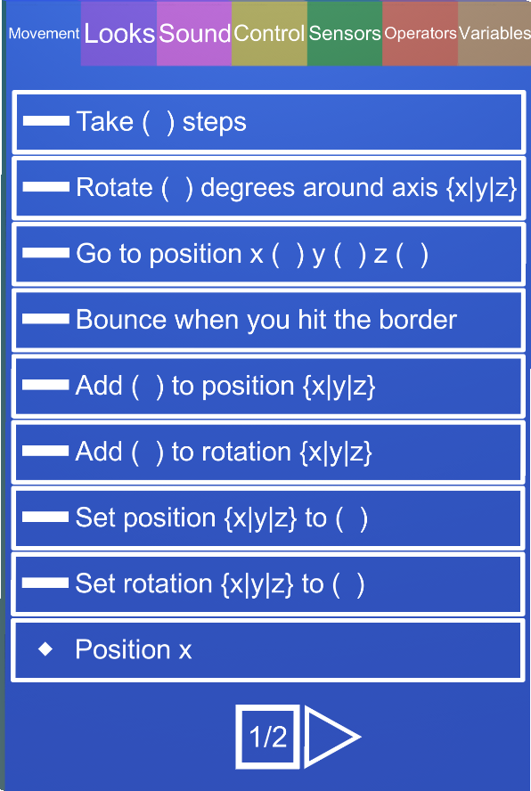
Interface (VI)
The scripting element insertion window allows you to instantiate elements that will be used to compose a script.
Items are categorized.
Each element is shown with its textual description and an icon indicating its type.
Variables tab contains both global variables and variables that are local to the active actor.

Slide 23
Demo
Creation of a program from scratch (actor that moves and says «Hello World»).
Factorial computation (iterative: new allocation record creation is not supported).
Actor following the controller and example the usage of the messaging system.

Slide 24
Conclusions
Possibilities of further development:
A proper saving and loading system, possibly emphasizing sharing (see Scratch Community).
Introduction of a function definition sub-system and correct handling of activation records (allowing, in particular, to define recursive functions).
Expansion of the repertoire of instructions under the sensors category by introducing blocks to detect collisions between actors.
VR/AR platforms are currently evolving:
Porting on smartphone-based platforms.
Consider porting on future platforms that are being developed (Google Daydream, Windows Holographic, Apple ARKit, new standalone headsets that will appear in the next few years).

